Slide 1
Training
SNOWFLAKE
DAY 3

Slide 2
Agenda
Stages
File formats
Role Hierarchy and Privilege Inheritance
Integration
Data Masking
Row Access Policy

Slide 3
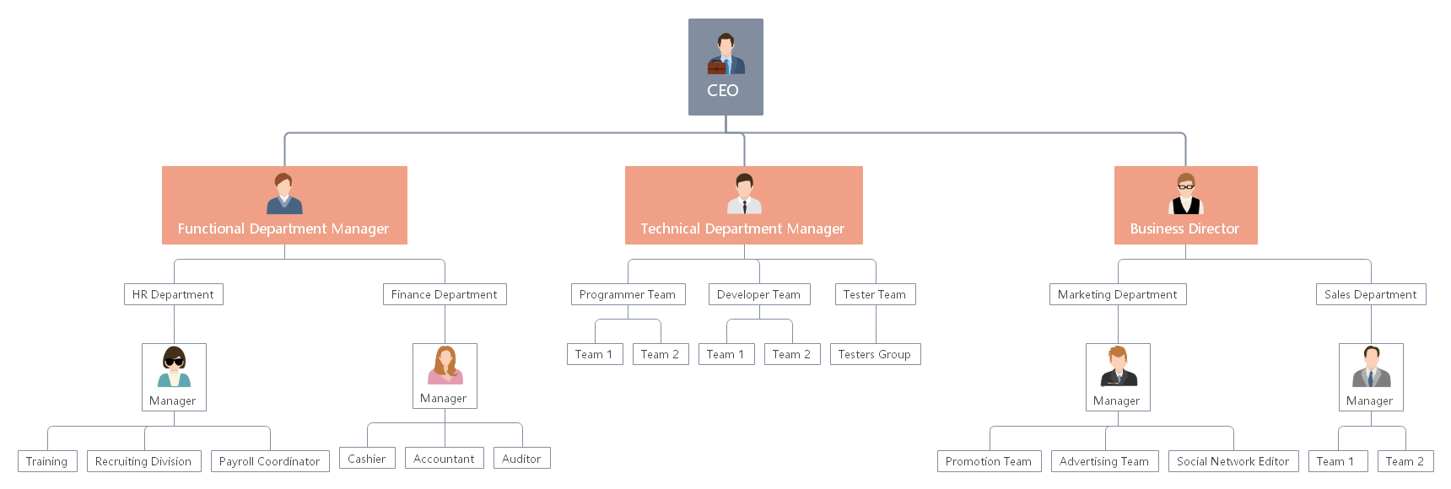
Role Hierarchy and Privilege Inheritance

Slide 4
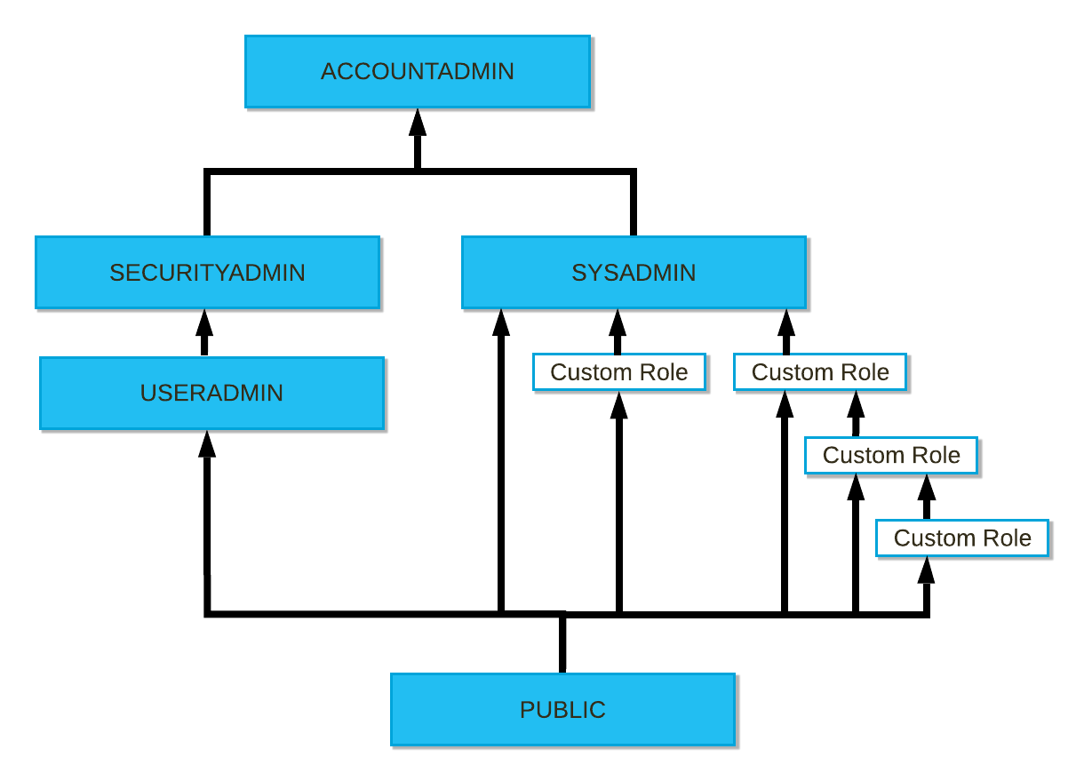
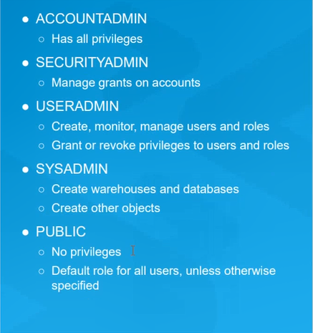
Role Hierarchy and Privilege Inheritance
Snowflake’s approach to access control combines aspects from both of the following models:
Discretionary Access Control (DAC): Each object has an owner, who can in turn grant access to that object.
Role-based Access Control (RBAC): Access privileges are assigned to roles, which are in turn assigned to users.

Slide 5
System Roles Overview
ACCOUNTADMIN: (aka ACCOUNT ADMINISTRATOR)
Role that encapsulates the SYSADMIN, SECURITYADMIN system defined roles.
It is the top-level role in the system and should be granted only to a limited/controlled no of users in account.
SECURITYADMIN: (aka SECURITY ADMINISTRATOR)
Role that can manage any object grant globally
As well as CREATE, MONITOR and MANAGE USERS and ROLES.
This role is granted the MANAGE GRANTS security privileges to be able to modify any grant, including revoking it.
It inherits privileges of USERADMIN role via system role hierarchy.
USERADMIN: (aka USER ADMINISTRATOR)
Role that is dedicated to USER and ROLE management only.
This role is granted the CREATE USERS and CREATE ROLE security privileges.
This role also manages users and roles that it owns. Only the role with ownership privilege on an object or higher role can modify object properties.
SYSADMIN: (aka SYSTEM ADMINISTRATOR)
Role that has privileges to create WAREHOUSES AND DATABASE OBJECTS in an account.
If as, recommended you create a role hierarchy that ultimately assigns all custom roles to SYSADMIN, this role has ability to grant privileges on warehouses and other database objects.

Slide 6
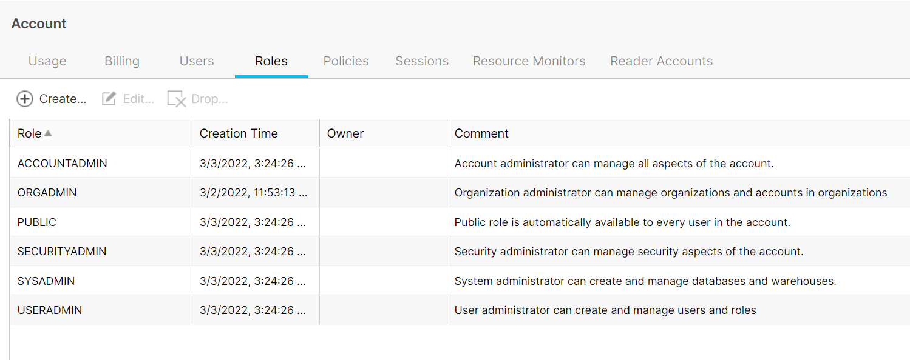
Pre-defined System Roles

Slide 7
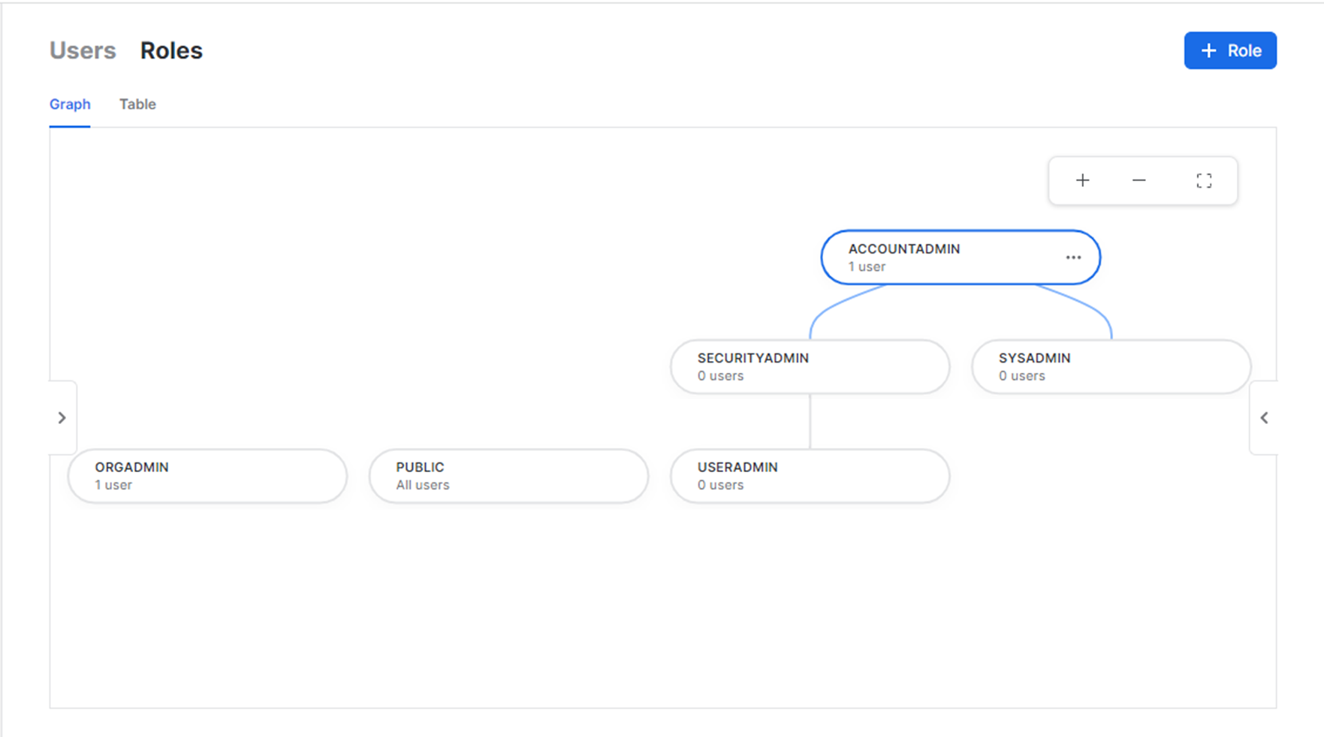
Pre-defined System Roles

Slide 8
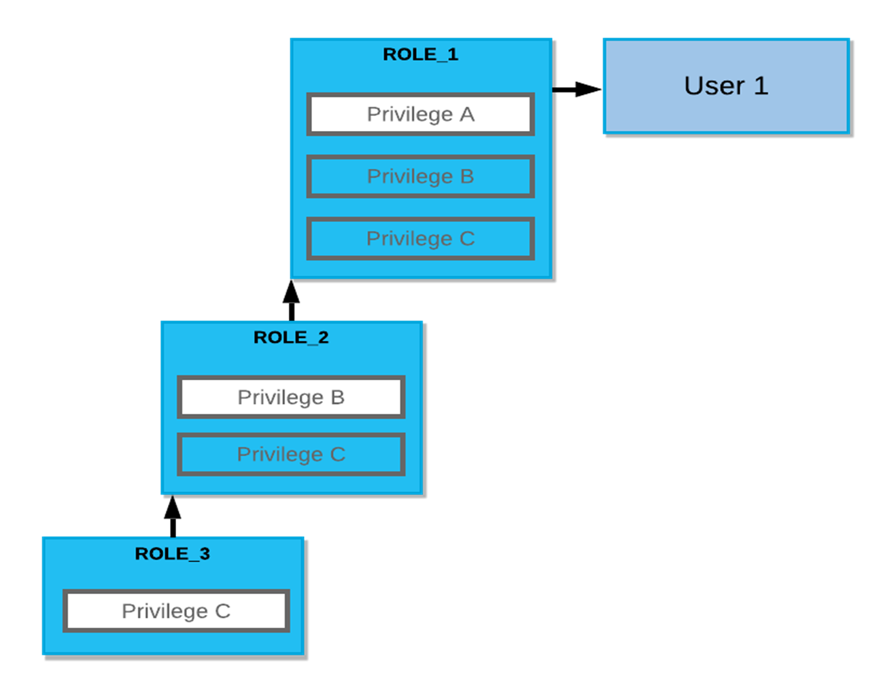

Slide 9
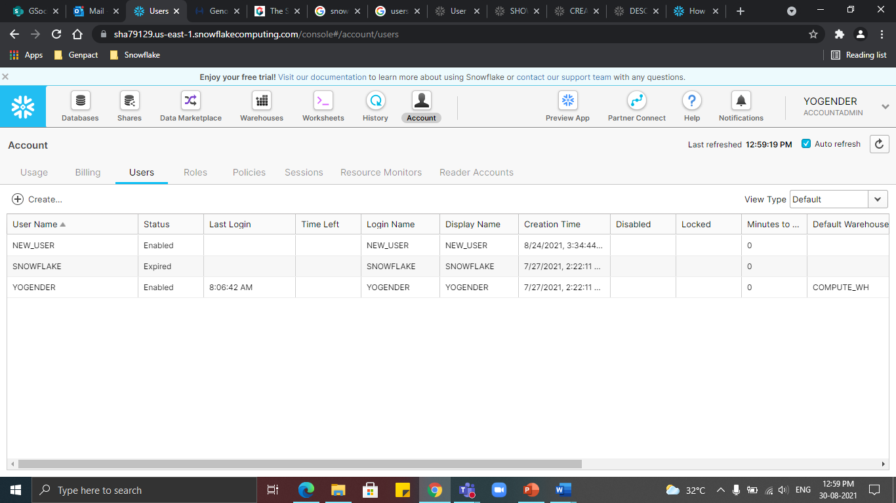
Snowflake Users

Slide 10
Stages
Internal stage : used for loading data from local storage to snowflake
Three types of internal stages:
User stage -User stages are tied to a specific user. Every user has a default stage created. We will not be able to either modify or remove these stages. We need to refer to the user stages using ‘@~’
Table Stage - Table stages are tied to a specific user. Whenever a table is created, then automatically table stage is created. Like the user stage will not be able to either modify or remove the table stage, however, we need to clean up space after the files are loaded. So, if you need to load one table then you can choose the table stage. We need to refer to the user stages using ‘@%’
Internal Named Stage - These stages offer more flexibility compared to user or table stages. We need to create these stages manually and we can also specify the file format options while creating the stage itself which is unlike the table or user stage. We need to refer to the user stages using ‘@’.
External stage : An external stage is a database object created in a schema. This object stores the URL to files in cloud storage, the settings used to access the cloud storage account, and convenience settings such as the options that describe the format of staged files.

Slide 11
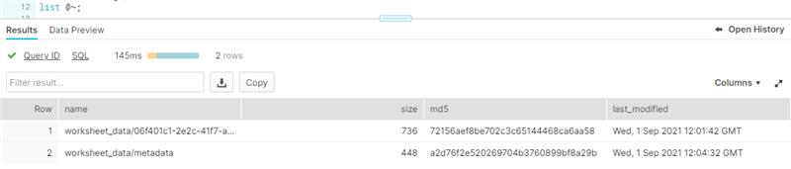
Stages
Internal stages:
Table stage:
SYNTAX: list @%<table_name>;
EXAMPLE: create table table(t int);
list @%table;
User stage:
SYNTAX: list @~
EXAMPLE:
​
Named stage:
SYNTAX: create stage <stage_name>;
list @<stage_name>
EXAMPLE: create stage internal_stage;
list @internal_stage;

Slide 12
File Formats
File Format is a pre-defined format structure that describes a set of staged data to access or load into Snowflake tables for CSV, JSON, AVRO, ORC, PARQUET and XML input types.
We can set a wide variety of parameters to set attributes such as Compression, File Delimiters, Skipping Headers, Data/Time Format, Encoding, Null handling etc for the data stored in the staged files before ingestion.
Syntax: CREATE FILE FORMAT <format_name>
COMPRESSION = 'AUTO'FIELD_DELIMITER='|’
RECORD_DELIMITER='\n'SKIP_HEADER=0;
Example: CREATE FILE FORMAT CSV_FORMAT
COMPRESSION = 'AUTO'FIELD_DELIMITER='|’
RECORD_DELIMITER='\n'SKIP_HEADER=0;

Slide 13
Integration
An integration is a Snowflake object that provides an interface between Snowflake and third-party services.
API INTEGRATION
NOTIFICATION INTEGRATION
SECURITY INTEGRATION
STORAGE INTEGRATION
Syntax
CREATE [ OR REPLACE ] <integration_type> INTEGRATION [ IF NOT EXISTS ] <object_name>
[ <integration_type_params> ]
[ COMMENT = '<string_literal>’ ]
Where integration_type_params are specific to the integration type.
SNF DOCUMENTATION

Slide 14
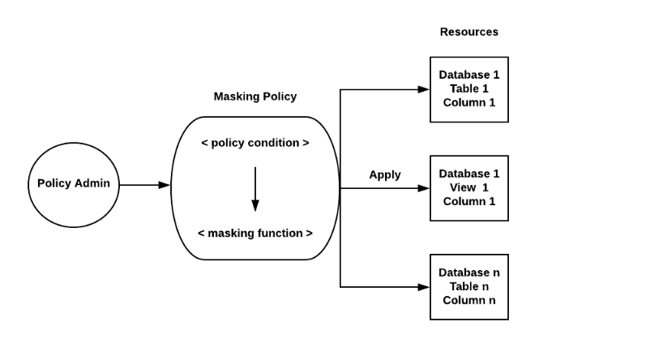
Data Masking
Dynamic Data Masking is a Column-level Security feature that uses masking policies to selectively mask plain-text data in table and view columns at query time.
At query runtime, the masking policy is applied to the column at every location where the column appears. Depending on the masking policy conditions, the SQL execution context, and role hierarchy, Snowflake query operators may see the plain-text value, a partially masked value, or a fully masked value.

Slide 15
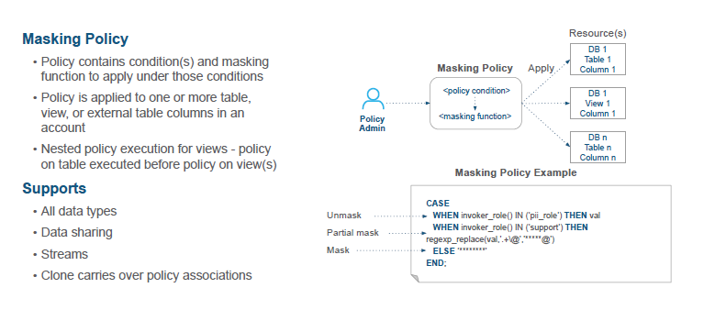
Data Masking

Slide 16
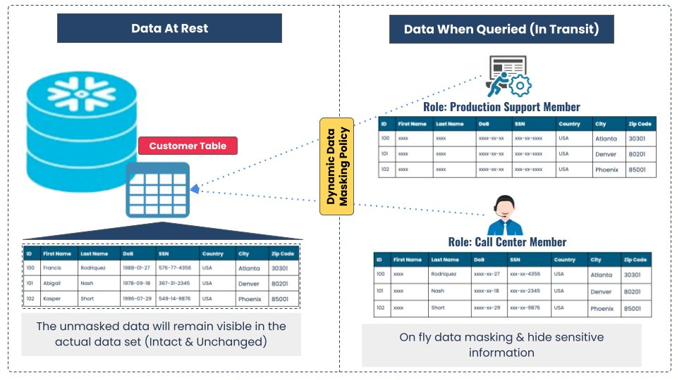
Data Masking

Slide 17
ROW ACCESS POLICY
Row access policy implements row level security to determine which rows are visible in the query result.
Row access policies can include condition and functions in the policy expression to transform the data at query runtime when those conditions are meet.
ROW LEVEL security:
Snowflake determines whether a row access policy is set on a database object. If a policy is added to the database objects, all rows are projected by policy
Snowflake create a dynamic secure view(Secure inline view) of the database.
The values of the columns specified in the ALTER TABLE or ALTER VIEW command(i.e., when adding a row access policy to a table or view) are bound to the corresponding parameters in the policy and the policy expression is evaluated.
Snowflake generates the query output for the user and the query output contains rows based on the policy definition evaluating to TRUE.

Slide 18
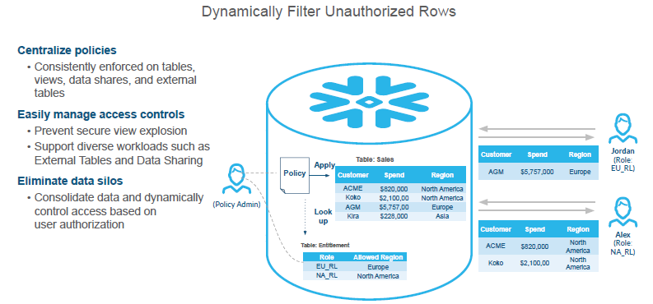
ROW ACCESS POLICY

Slide 19
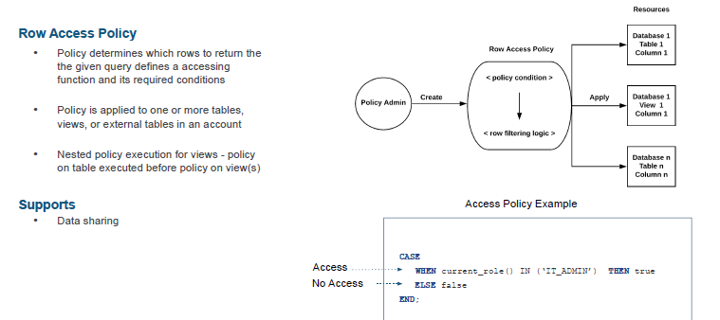
ROW ACCESS POLICY

Slide 20
ROW ACCESS POLICY
Syntax:
create or replace row access policy <policy_name> as (col_name col_datatype, ..) returns boolean ->
CASE WHEN <col_name> = 'F70' THEN 'F60' ELSE <col_name> END;
Summary:
Object owner also cannot see the records after applying policies unless we mention object owner role while creating policy.
You can only apply one policy at time on the table
You can use multiple columns as input parameter for policy

